Slide 1
ray-tracing of a beamline with SHADOW
Luca Rebuffi, Xianbo SHI (ANL)
Beamline Optics Design and Simulation Workshop
Hamburg, Germany
May 19-22, 2025

Slide 2
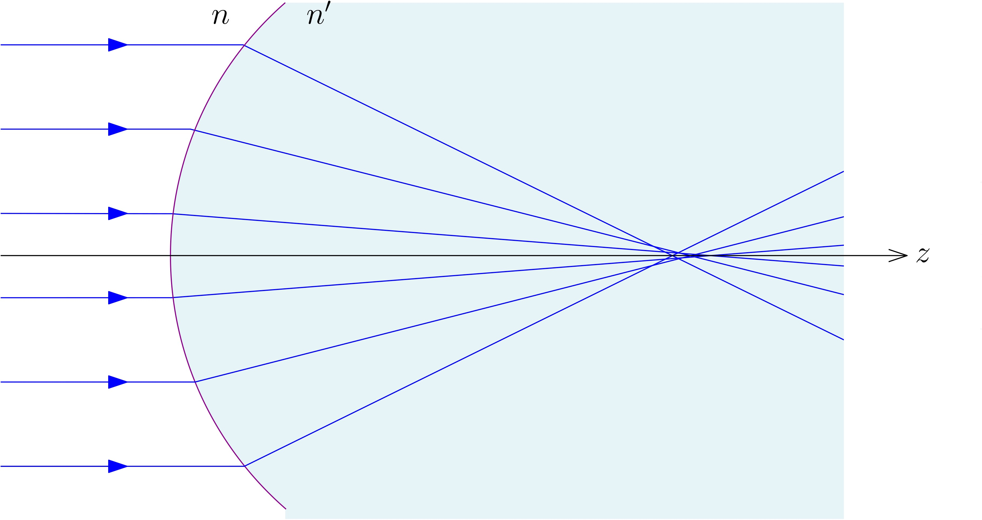
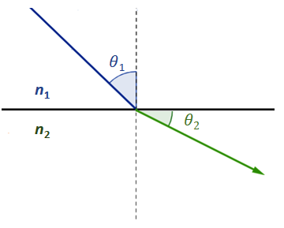
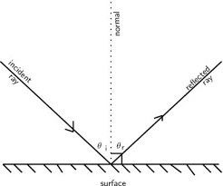
Ray Tracing and Geometrical Optics
Geometrical optics, or ray optics, is a model of optics that describes electromagnetic radiation propagation in terms of rays, that are an abstraction useful for approximating the paths along which light propagates.
Rays propagate in straight-line paths as they travel in a homogeneous medium. They follow the laws of reflection and refraction or are absorbed.
Ray tracing is a method for calculating the path on rays that relies on approximate solutions to Maxwell's equations that are valid as long as the light waves propagate through and around objects whose dimensions are much greater than the light's wavelength. Ray theory does not describe phenomena such as interference and diffraction, which require wave theory.

Slide 3
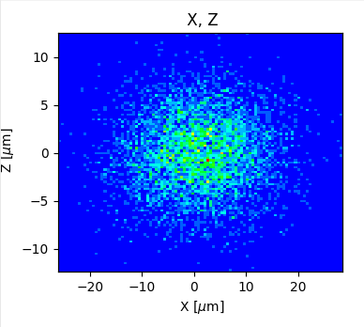
Ray Tracing and Geometrical Optics
z
Ray Tracing optical simulations are based on a Montecarlo approach:
Several thousands rays are randomly generated on a source plane, by choosing their initial position and direction, according to the characteristic of the synchrotron radiation source
Every ray is propagated through the optical system according to the laws of geometrical optics
The result is obtained by accumulating all the rays intercepting one ore more observation planes
x
Energy, Intensity
y
y
z
z
p
q
x
y
x

Slide 4
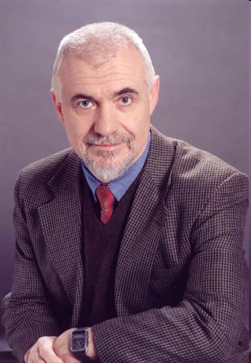
Birth of Shadow (~1980)
Scientific motivation: Grating monochromator design, TGM, ERG, toroidal, spherical mirrors.
Monte Carlo ray tracing program designed to simulate X-ray optical systems
Requirements
Accuracy and reliability
Easy to use
Flexibility
Economy of computer resources
VAX-11 Computers
Efficient MC approach
Reduced number of rays
Exact simulation of SR sources
Vector calculus
Modular
User-interface
Available to users
Two years development
Fortran 77+VAX/VMS extensions
Franco Cerrina
(♰2010)

Slide 5
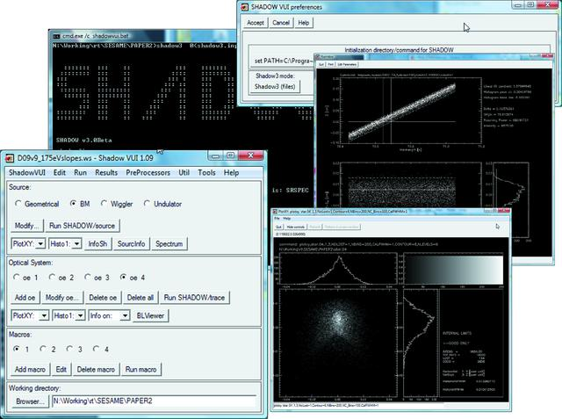
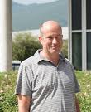
Shadow 3 (2010)
https://github.com/oasys-kit/shadow3
Manuel
Sanchez Del Rio
Python3 API
M. Sanchez del Rio, N. Canestrari, F. Jiang and F. Cerrina "SHADOW3: a new version of the synchrotron X-ray optics modelling package" Journal of Synchrotron Radiation Volume 18, Part 5 (September 2011) http://dx.doi.org/10.1107/S0909049511026306

Slide 6
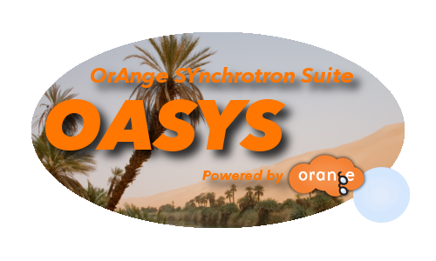
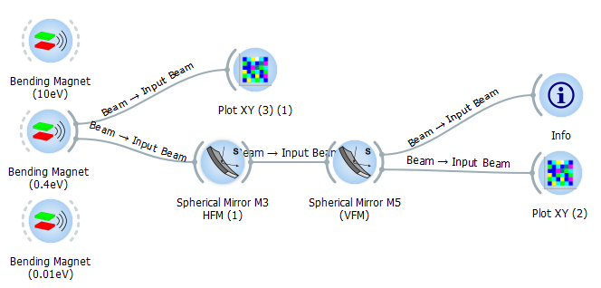

OASYS – ShadowOui (2014)
Manuel
Sanchez Del Rio
OASYS + Shadow3
Luca Rebuffi

Slide 7
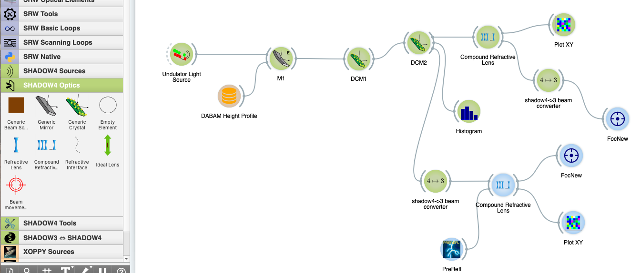
OASYS – Shadow4 (2024)
Fully developed in Python
100% Based on SYNED
Simplified and Optimized GUI
No Pre-Processor Files
S.I. units
Standalone Shadow4 API
+
OASYS GUI AddOn

Slide 8
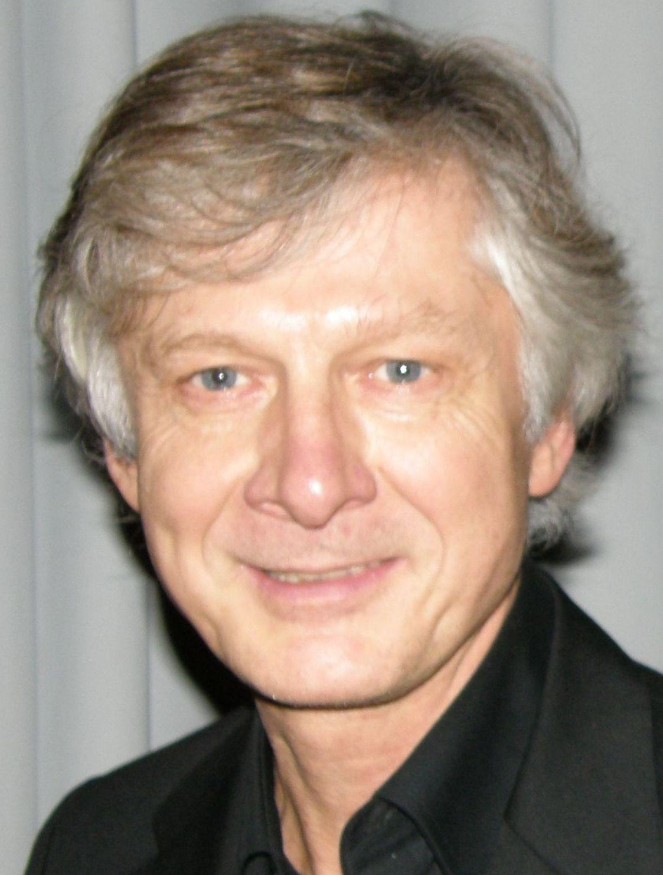
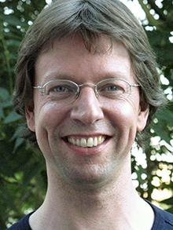
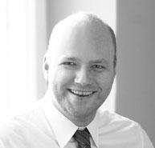
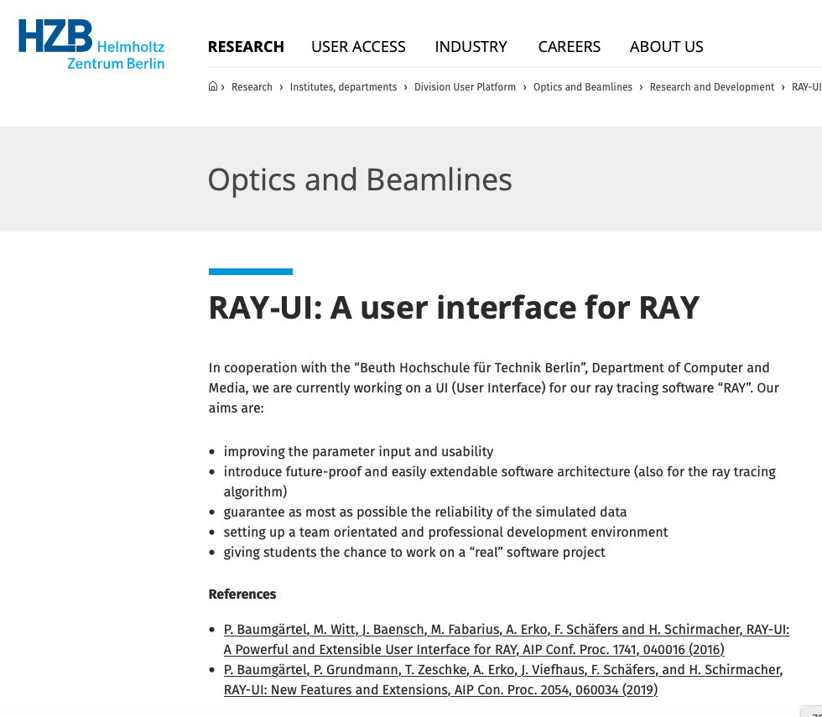
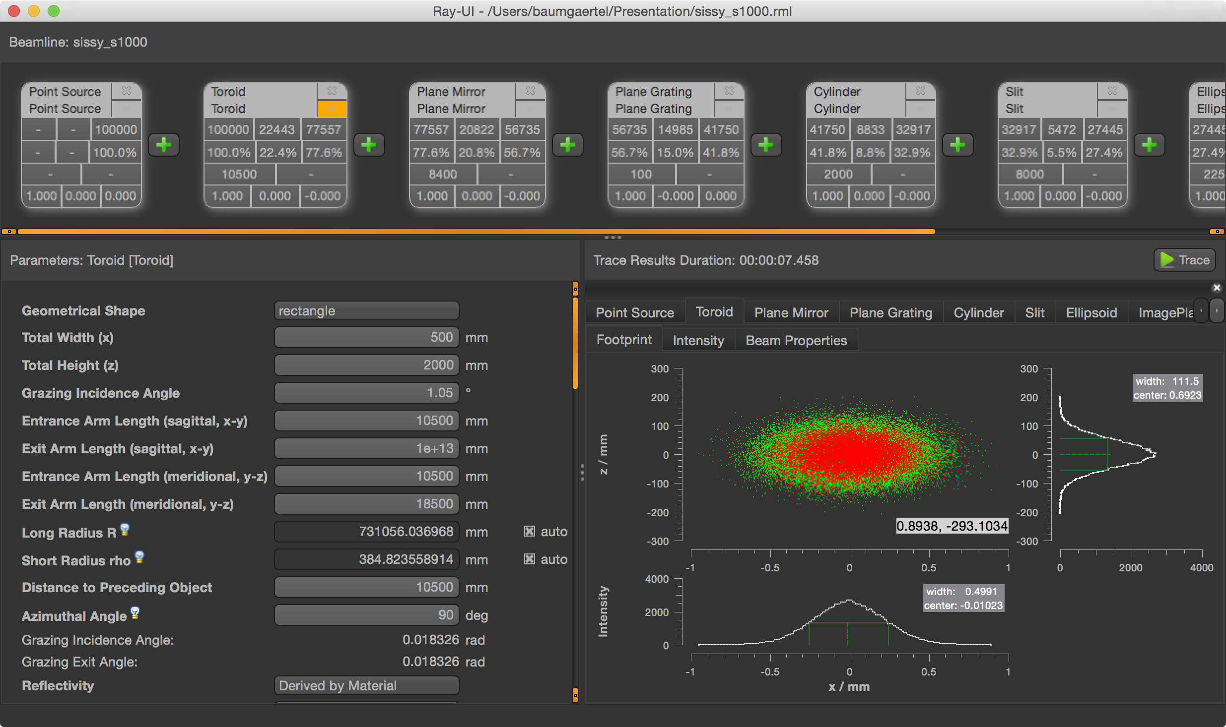
RAY-TRACING simulations: RAY
https://www.helmholtz-berlin.de/forschung/oe/np/optik-strahlrohre/arbeitsgebiete/ray_en.html
Franz Schäfers
Peter Baumgärtel
Hartmut Schirmacher

Slide 9
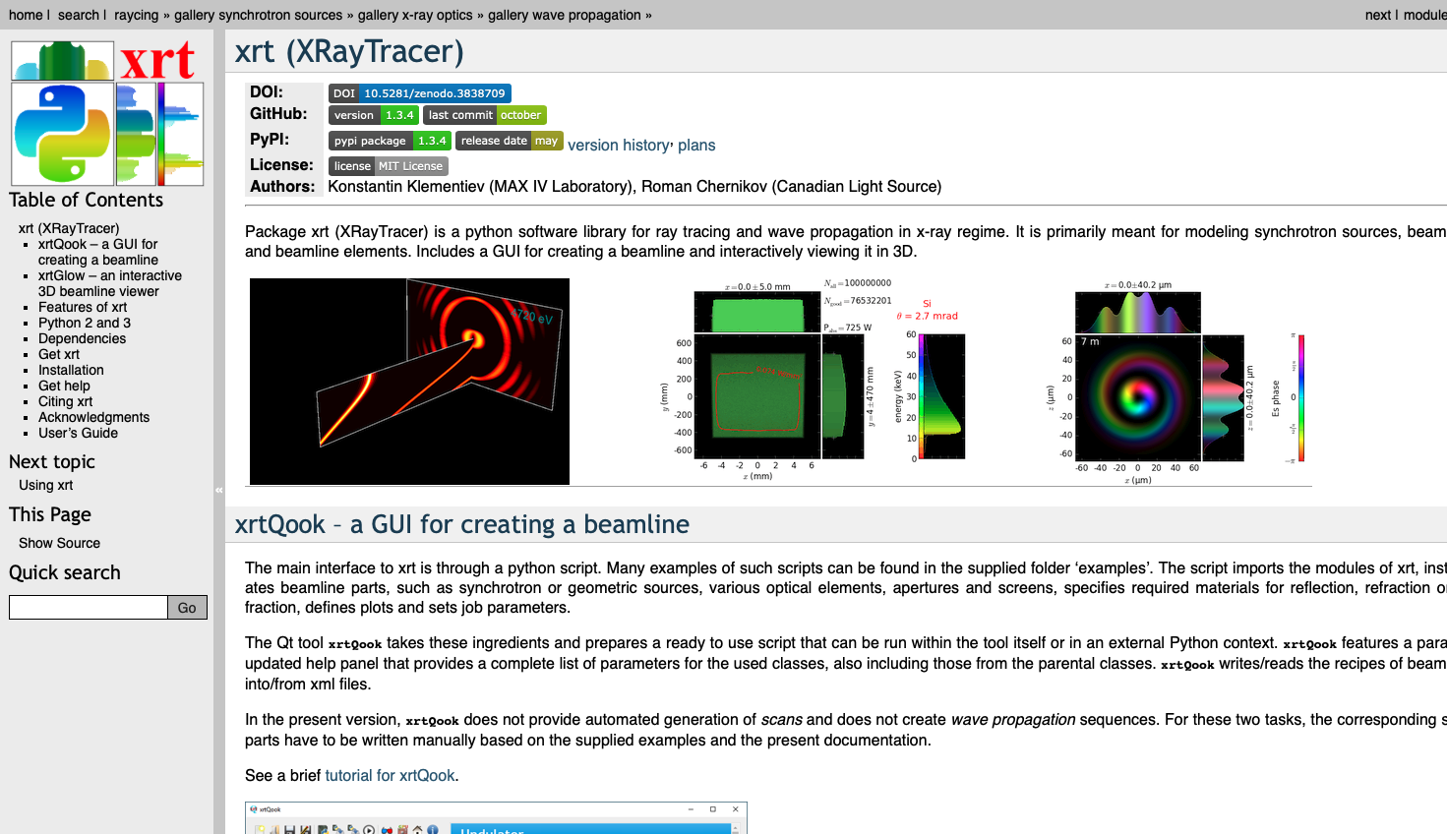
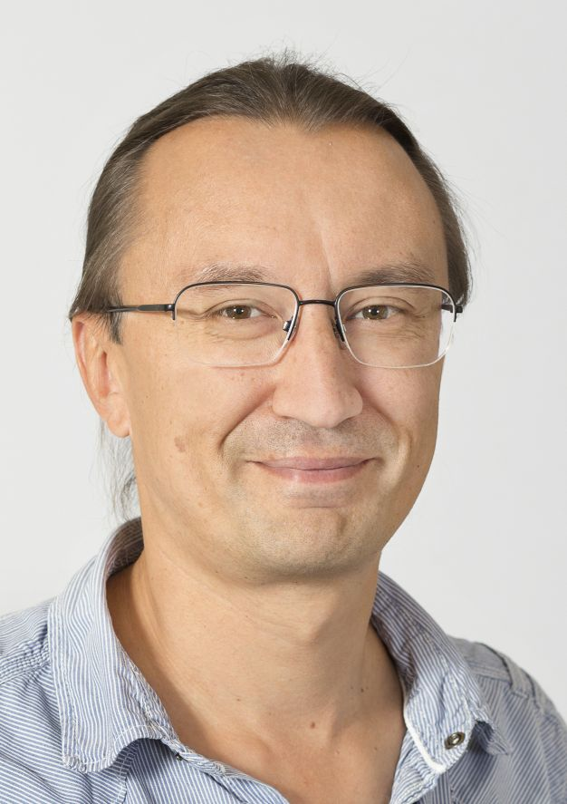
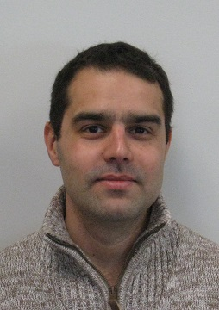
RAY-TRACING simulations: XRT
Konstantin Klementiev
Roman Chernikov
http://www.mcxtrace.org
https://xrt.readthedocs.io

Slide 10
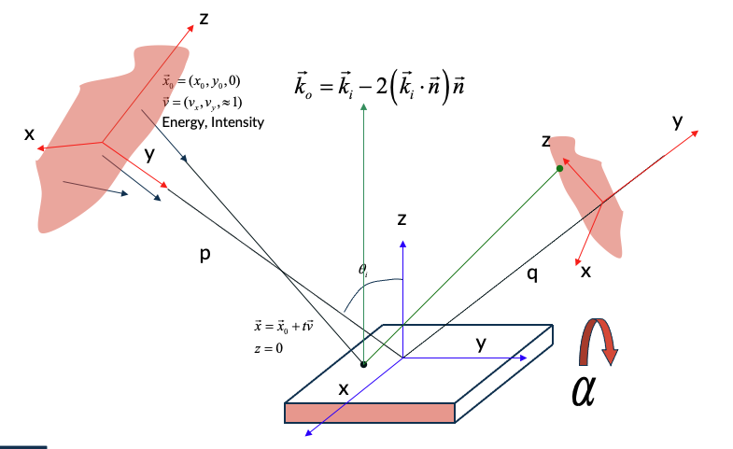
Ray Tracing: Shadow and Shadow(Oui/4)
Basic Shadow :
Each optical element has an incident beam, that is located on a plane called Source Plane.
Each Optical Element has the axis system always oriented with Z normal to the optical surface, Y tangent to the surface along the direction of propagation of the beam and X tangent to the surface and normal to Z and Y.
The orientation of the optical surface is given by the angle of rotation 𝜶 along the Y axis and is relative to the axis system of the incident beam, as defined in the source plane.
The beam is traced up to Image Plane, which has the Y axis oriented as the direction of propagation of the beam (that will depend on the particular optics) and Z, X in the same plane of the same axis of the Optical Element.
Source Plane
Image Plane
Optical Element

Slide 11
Beamline and Optical Elements for Synchrotron Radiation
The radiation produced by the source must be collected and transported to the experimental station to perform the experiments. Typically, the radiation is focused to maximize the flux at the sample and minimize the spatial resolution. Moreover, the radiation is monochromatized to select one specific energy.
detectors
monochromators
sources
mirrors
slits
filters

Slide 12
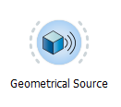
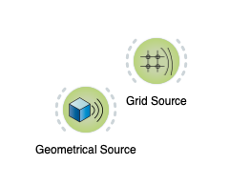
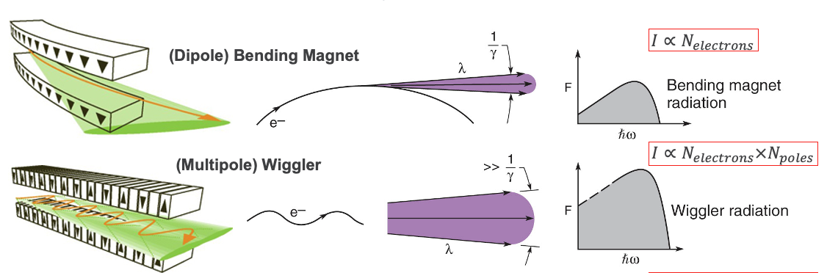
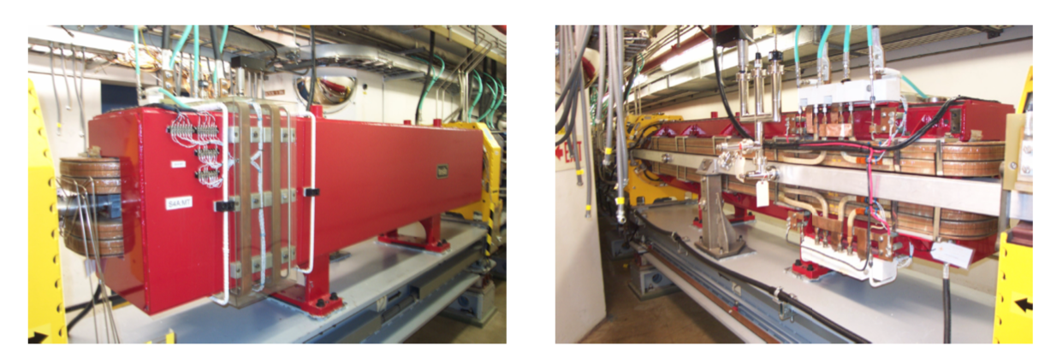
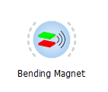
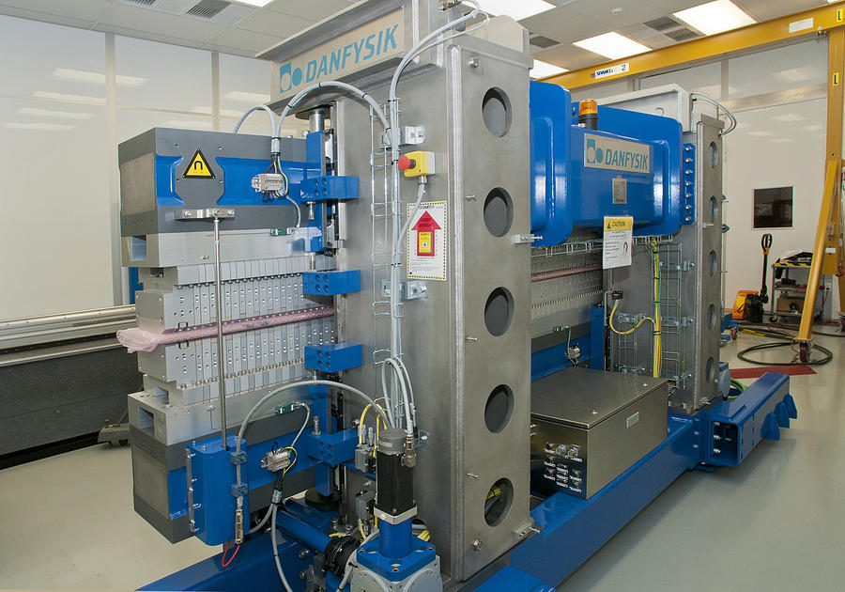
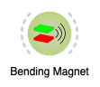
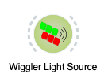
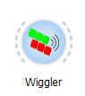
Shadow(Oui/4): Sources
Shadow initial beam is generated by a Source element
Fully customizable Sources

Slide 13
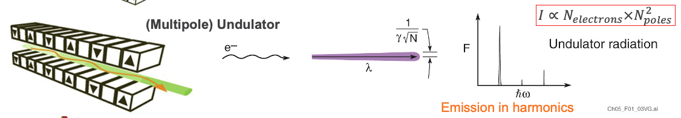
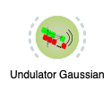
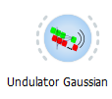
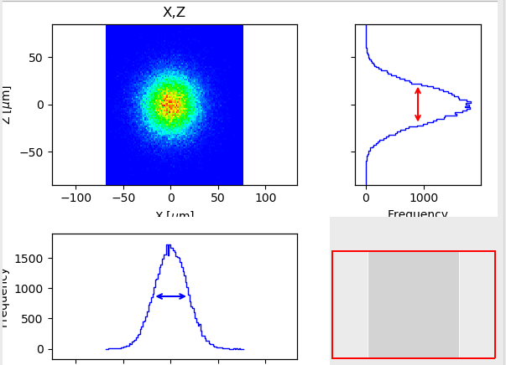
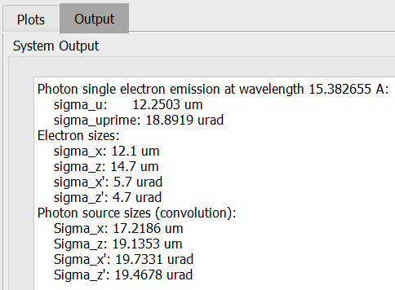
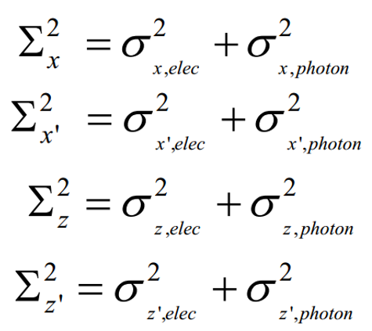
Shadow(Oui/4): Sources
Fake Geometrical Source
(Gaussian spatial + Gaussian divergency)
Single e⁻
Photon source:
Divergence:
Size:

Slide 14
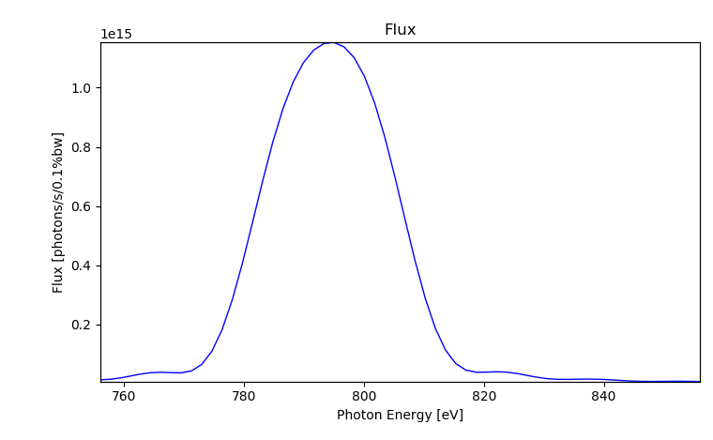
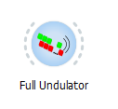
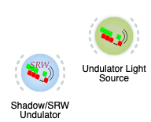
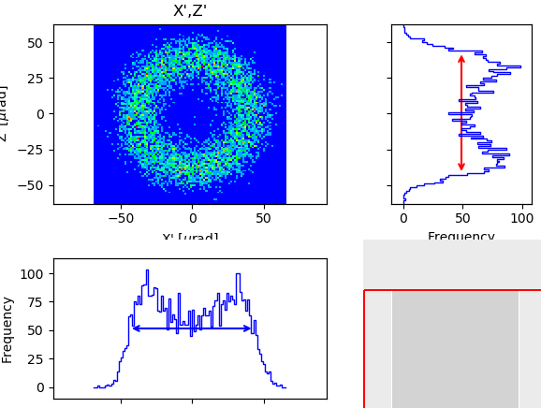
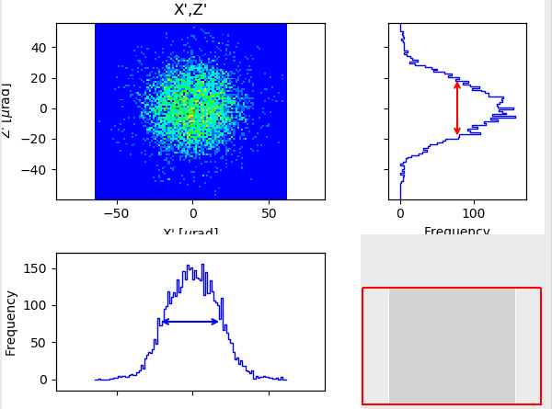
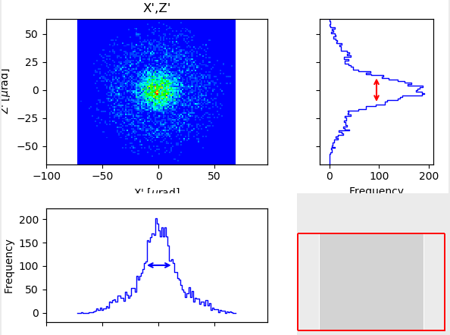
Shadow(Oui/4): Sources
Full Undulator
789.938eV
806.060eV
814.121eV

Slide 15
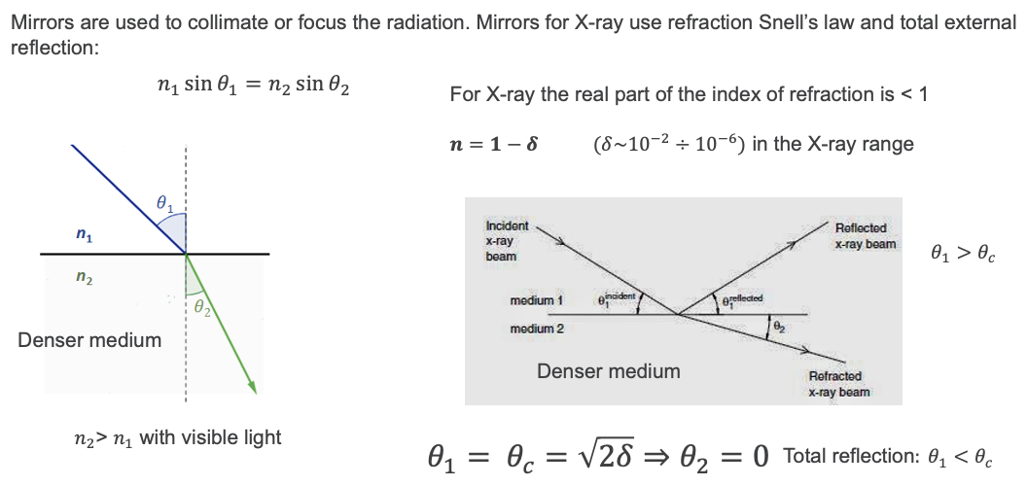
Shadow(Oui/4): Mirrors

Slide 16
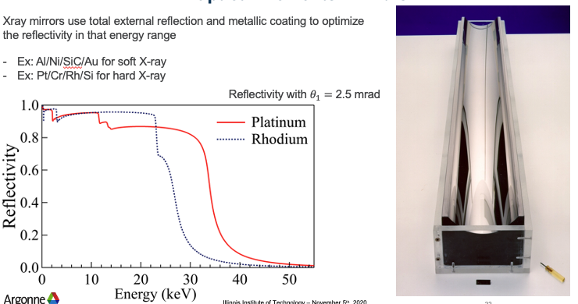
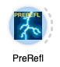
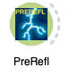
Shadow(Oui/4): Mirrors
Shadow can include reflectivity after tracing the rays geometrically

Slide 17
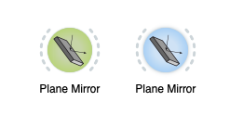
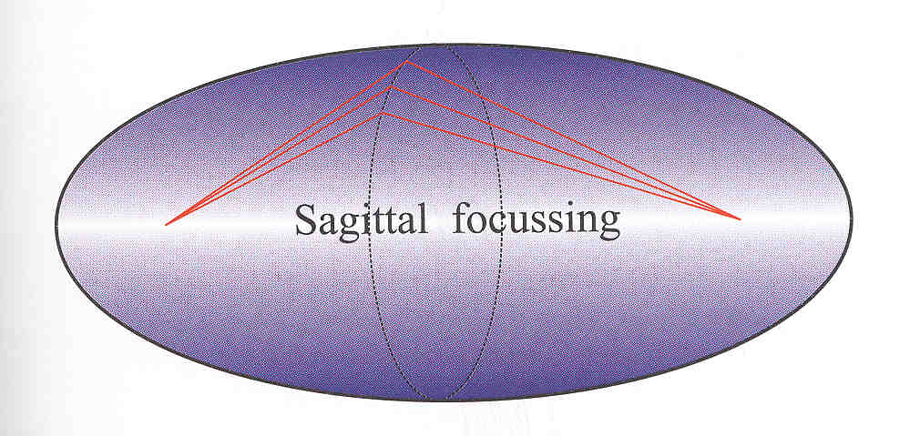
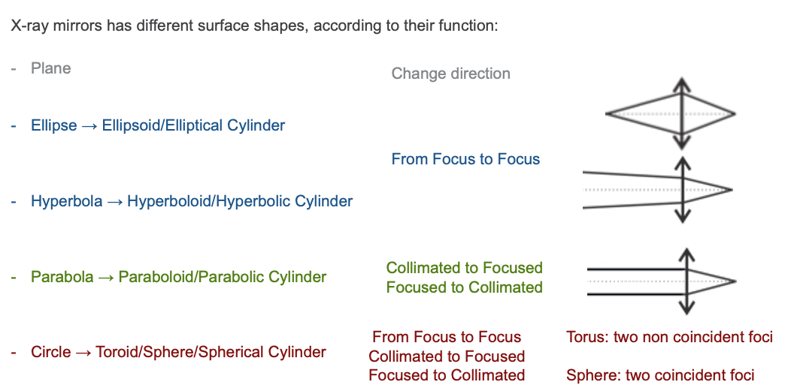
Shadow(Oui/4): Mirrors
R
p
q
ρ
M = p/q

Slide 18
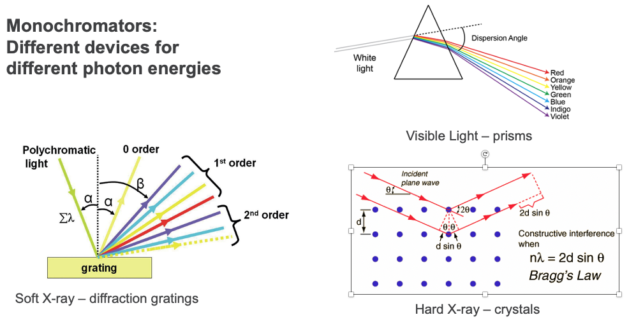
Shadow(Oui/4): Monochromators

Slide 19
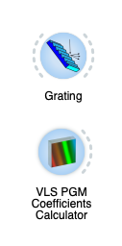
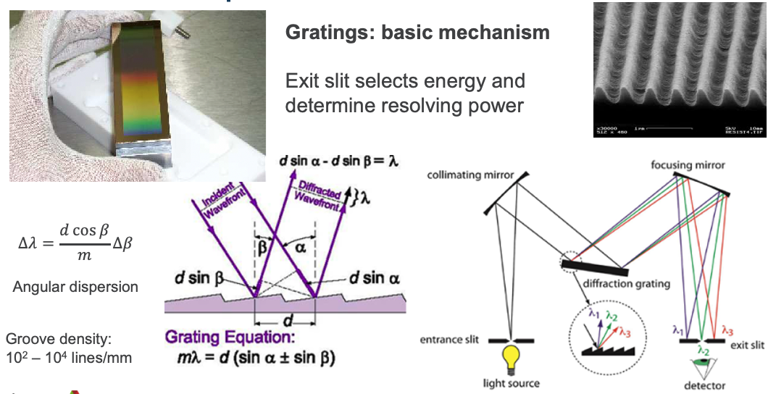

Shadow(Oui/4): Gratings
No model (yet) in SHADOW for grating efficiency

Slide 20



Shadow(Oui/4): Crystals

Slide 21



Shadow(Oui/4): Multilayers

Slide 22



Shadow(Oui/4): X-Ray Lenses
p
q

Slide 23









Shadow(Oui/4): X-ray Lenses
Single interface
Lens
Transfocator
1996 Experimental demonstration of CRL: A. Snigirev et al Nature 384 (1996) 49

Slide 24






Manufacturing Errors
Surface Errors:
Height Profile Simulator
Surface Errors:
DABAM
Direct link
Common format
ShadowOui Widget
Shadow4 uses Syned
SRW Widget
SYNED Widget

Slide 25
Advanced Features
Hybrid Method
Thickness Error Profiles for Refractive Elements
Bendable Mirrors
Loops for Optical Specifications (ShadowOui)
Loops for Thermal Load (ShadowOui)
X. Shi

Slide 26
Shadow(Oui/4): References
L. Rebuffi, M. Sanchez del Rio, "ShadowOui: A new visual environment for X-ray optics and synchrotron beamline simulations”, J. Synchrotron Rad. 23 (2016). DOI:10.1107/S1600577516013837
​​​​​M. Sanchez del Rio, D. Bianchi, D. Cocco, M. Glass, M. Idir, J. Metz, L. Raimondi, L. Rebuffi, R. Reininger, X. Shi, F. Siewert, S. Spielmann-Jaeggi, P. Takacs, M. Tomasset, T. Tonnessen, A. Vivo and V. Yashchuk, "DABAM: an open-source database of X-ray mirrors metrology", J. Synchrotron Rad. 23 (2016). DOI: 10.1107/S1600577516005014
L. Rebuffi, X. Shi, M. Sanchez del Rio, R. Reininger, "A ray-tracing algorithm for ab initio calculation of thermal load in undulator-based synchrotron beamlines", J. Synchrotron Rad. 27 (2020). DOI: 10.1107/S160057752000778X
​​​​​L. Rebuffi, X. Shi, "Advanced simulation tools in the OASYS suite and their applications to the APS-U optical design", Proc. SPIE 11493, 1149303 (2020)​. DOI: 10.1117/12.256750
M. Sanchez del Rio, J. Reyes-Herrera, X. Shi and L. Rebuffi, “SHADOW4: the popular ray tracing revived for evolving synchrotron sources in fourth-generation storage rings ”, accepted for publication

